Slide 1
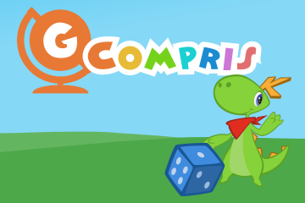
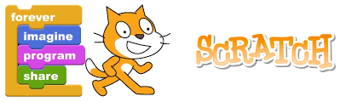
Scratch and Gcompris
A block based visual programming language
educational software suite

Slide 2
Scratch - What is it ??
Scratch is a graphical programming language, developed by the Lifelong Kindergarten group at the Massachusetts Institute of Technology.
Children can drag and combine code blocks to make a range of programs, including animations, stories, musical instruments and games.
Scratch allows children to learn coding concepts and create interactive projects without needing to learn a text-based programming language. This means they won’t be slowed down by their keyboard skills or the ability to remember complex code.
If children have a Scratch user account then projects can also be shared online with the Scratch community, giving children a real audience for their creations.
Scratch can either be used online in a web browser, or downloaded and used offline

Slide 3
History of Scratch
Scratch began development in 2003 and was released to the public in 2007. Scratch 1.0, the first version, was very similar to Scratch 1.4. At that time, only the offline editor existed; the website was a small blog where projects could be uploaded and played. As Scratch grew, the website was made larger.
Scratch 1.1, Scratch 1.2, Scratch 1.3, and Scratch 1.4 were released. At this point, Scratch had millions of users and projects, and a lot of new features.
Upon the release of Scratch 2.0 in 2013, the website and User Interface were changed. Scratch continued to grow, achieving 30 million users and projects. Scratch 3.0 was released in 2019.
Origin of the Word
“Scratch" was used as the title for The Lifelong Kindergarten Group's programming language, as it is to do with "scratching" referring to music.

Slide 4
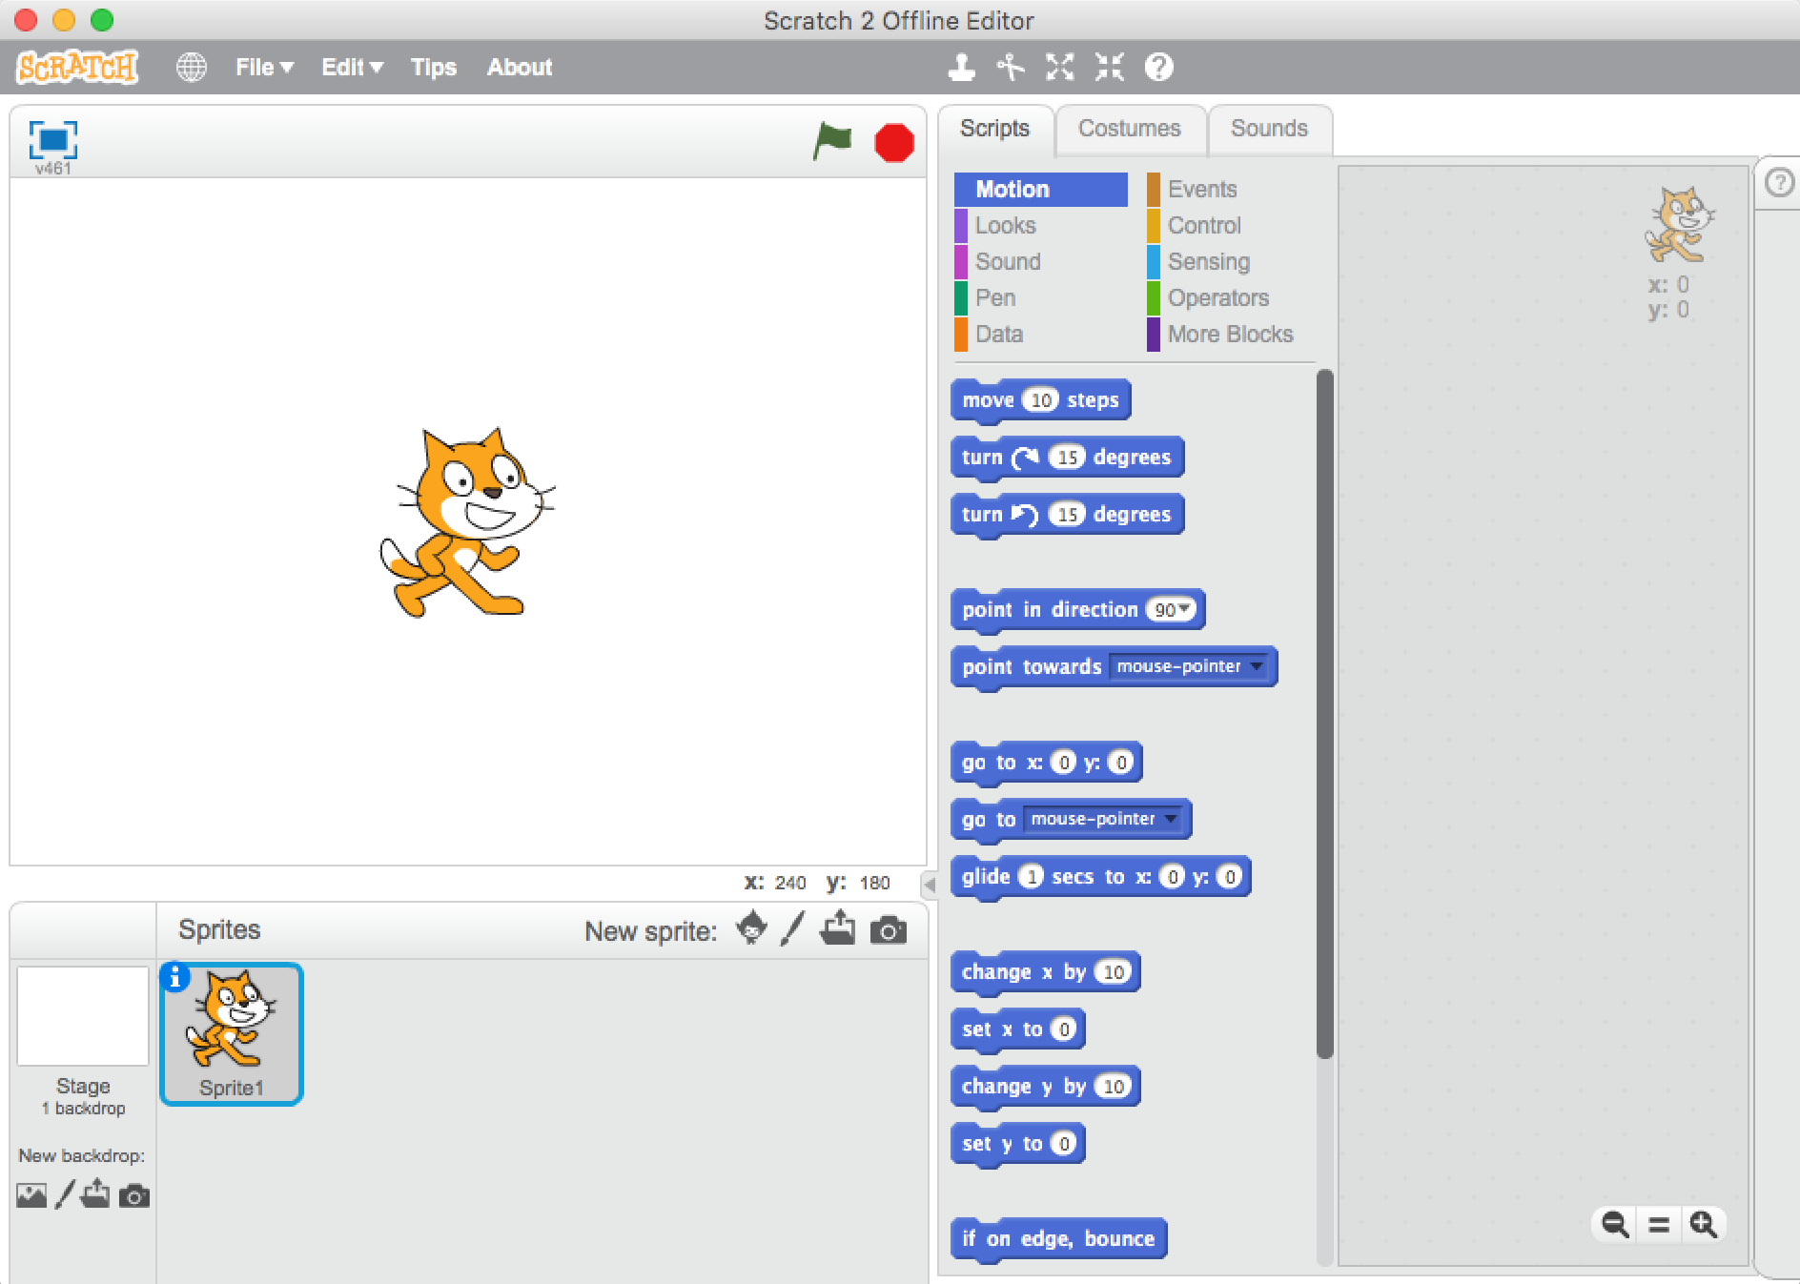
How Scratch looks…?

Slide 5
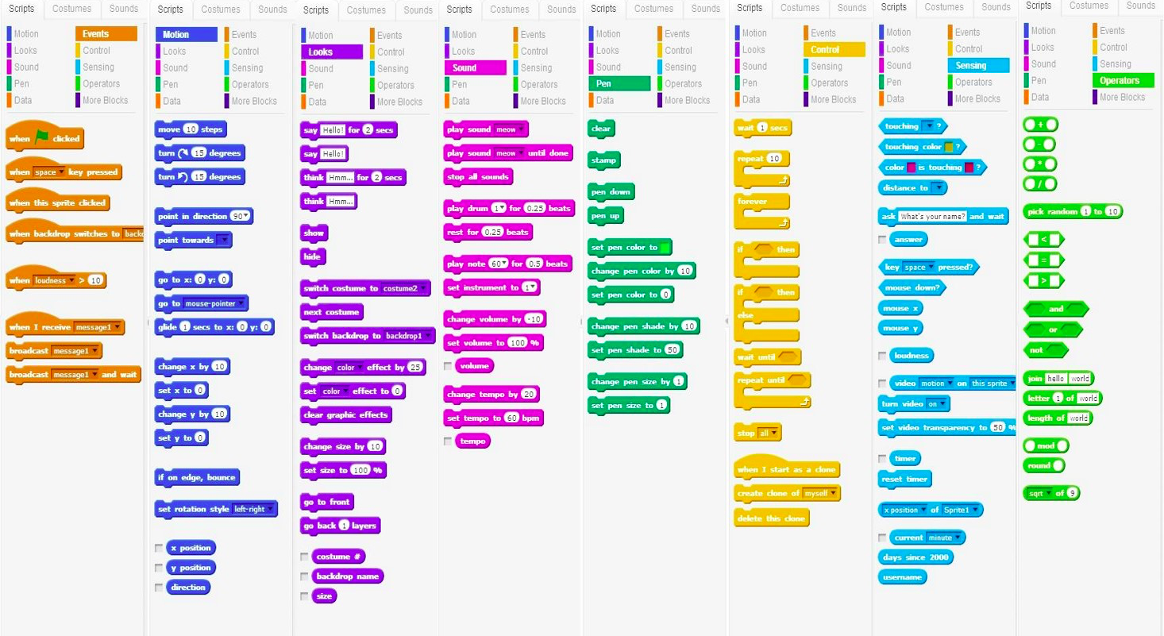
Pallets

Slide 6
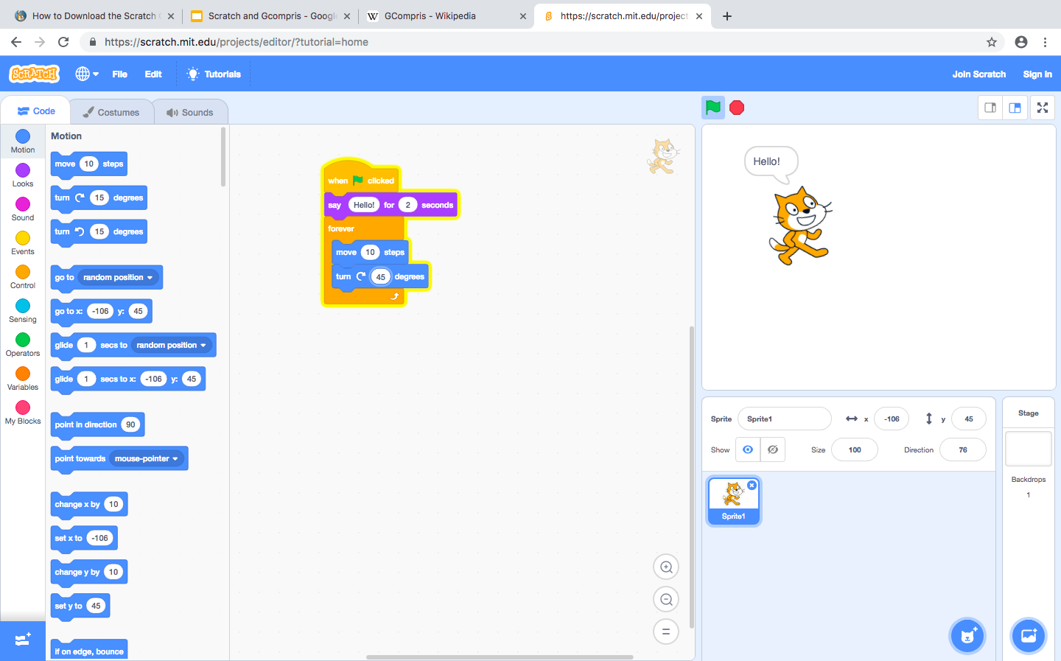
Example : Say hello !!!

Slide 7
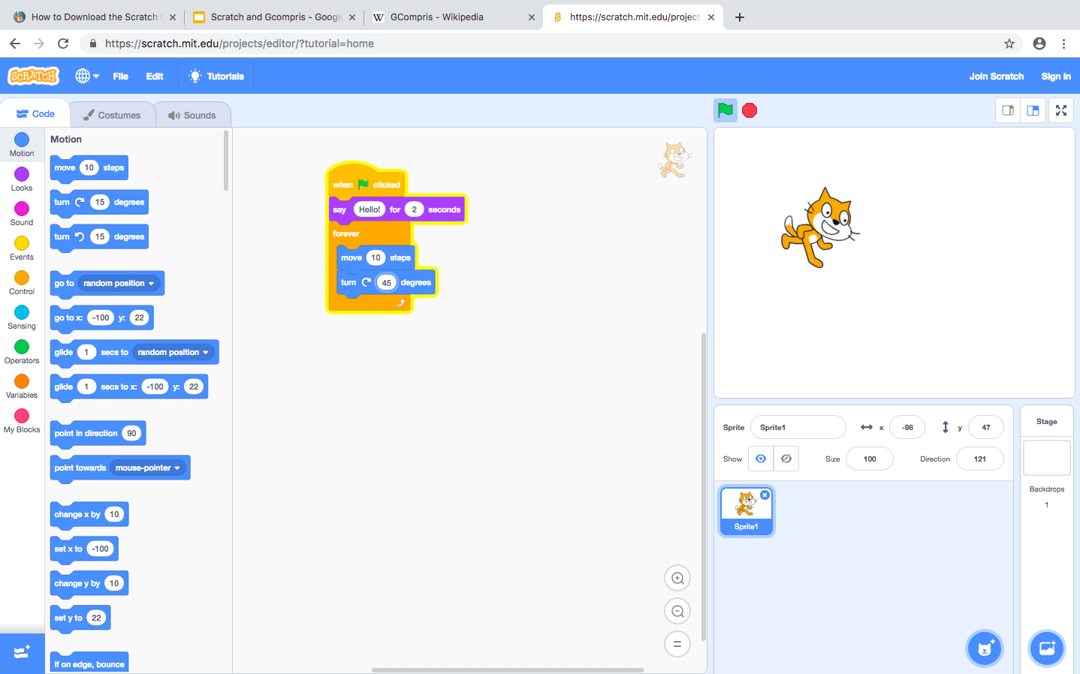
Turn and rotate

Slide 8
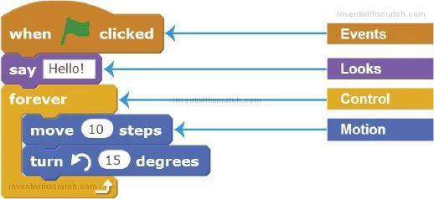
How it works
When ever the green flag is clicked (event) the spinter says hello (look) and a controlling loop runs that moves the spinter 10 steps ahead and turns it into 15 degree

Slide 9
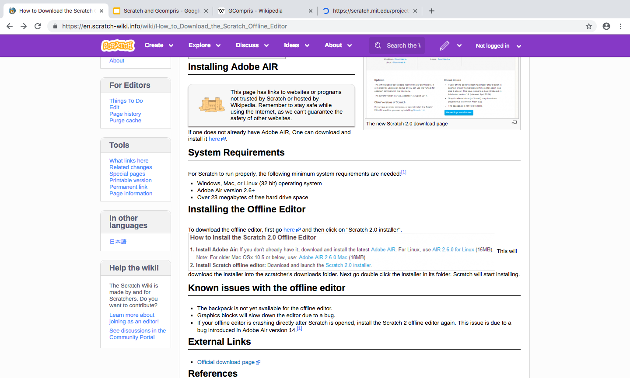
Start your work by downloading scratch….!!

Slide 10
Features of Scratch
Scratch has been completely rewritten in Adobe Flash for version 2.0 but still runs projects from older versions of Scratch.
It is still completely free and without ads.
Due to the new features and different programming language, Scratch 2.0 projects are saved in the .sb2 format
It is primarily event-driven.
Scratch has variables and lists for data storage, and arrays can be replicated.
Scratch is not atomic in repetition, though that can be simulated with Single Frame programming.
Scratch 2.0 does support procedures, and recursion.
Scratch has many simplified casting rules. Data is not, however, first-class — you cannot have first-class lists, sprites, or procedures (lambda).

Slide 11
GCompris
GCompris is a software suite comprising educational entertainment software for children aged 2 to 10.
GCompris was originally written in Cand Python using the GTK+ widget toolkit, but a rewrite in C++ and QML using the Qt widget toolkit is since early 2014 in process.
GCompris is free and open-source software subject to the requirements of the GNU General Public License version 3 and has been part of the GNU project
The name GCompris is a pun, in the French language is pronounced the same as the phrase "I have understood"
It is available for Linux, macOS and Windows. Binaries compiled for Microsoft Windows and macOS are distributed with a restricted number of activities; it is possible to access all the activities for a fee.

Slide 12
Activities provided by GCompris
Computer discovery: keyboard, mouse, different mouse gestures
Numeracy: table memory, enumeration, double entry table, mirror images
Science: the canal lock, the water cycle, the submarine, electric simulations
Geography: place the country on the map
Games: chess, memory, connect 4, oware, sudoku
Reading: reading practice
Other: learn to tell time, puzzle of famous paintings, vector drawing, cartoon making

Slide 13
History of GCompris
The first version of the game was made in 2000 by Bruno Coudoin, a French software engineer. Since the first release it was distributed freely on the Internet and was protected by the GNU General Public License.
The motivation behind the development was to provide native educational application for Linux. Since then, the software has seen continuous improvements, in terms of graphics and number of activities, thanks to the help of many developers and graphic artists joining the project over the years.
There are two branches of GCompris; with released versions in each. The first, older of which is the GTK+ branch that contains 140 activities is now considered to be a legacy branch in maintenance mode, with no new development^{[4]}. The latest release of the GTK+ version is 15.10 of 18 Oct. 2015^{[5]}.
The newer branch of Gcompris is completely rewritten using Qt Quick.
The current version is developed using JavaScript, QML and C++ languages. An Android and Raspberry Pi versions are available for download.^{[7]}

Slide 14
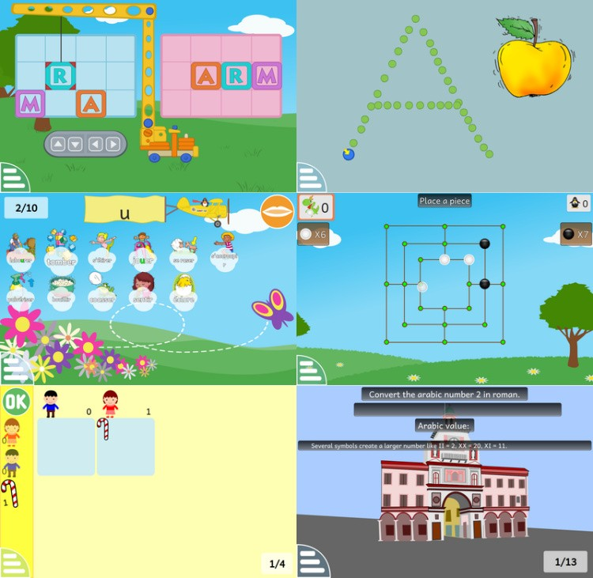
Sample Activities

Slide 15
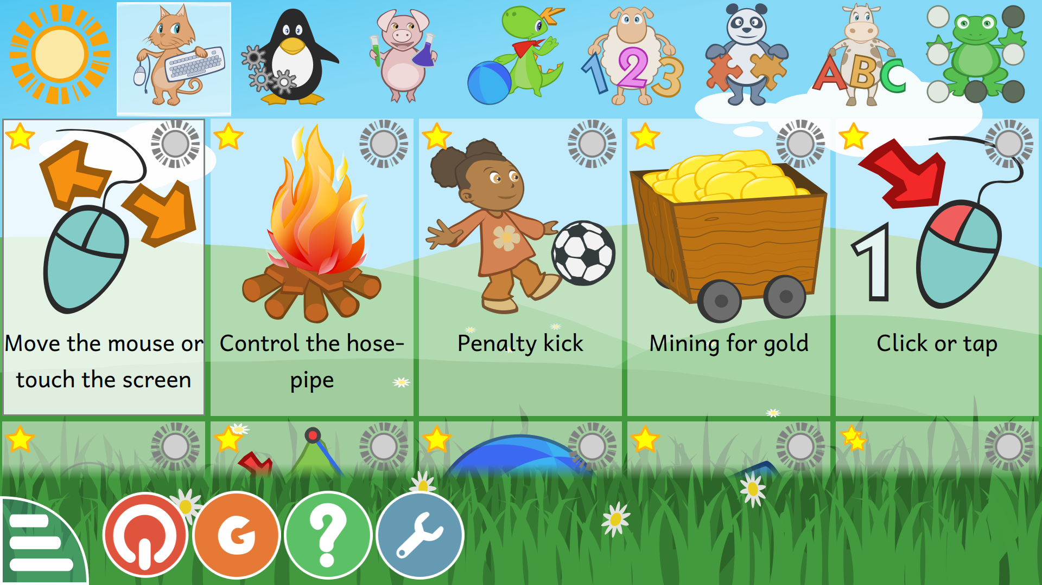

Slide 16
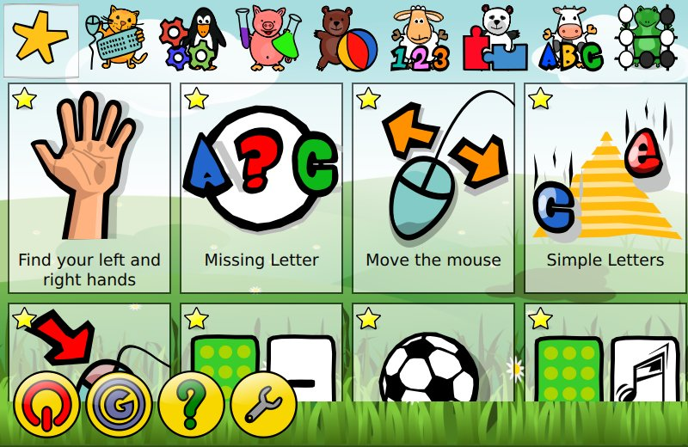

Slide 17
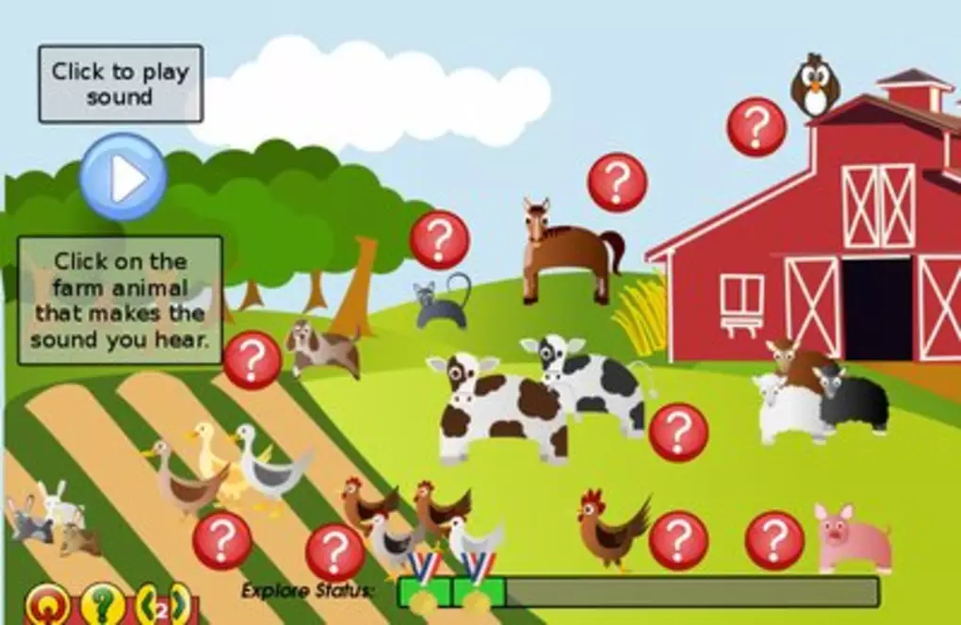
Learning stuffs for children

Slide 18
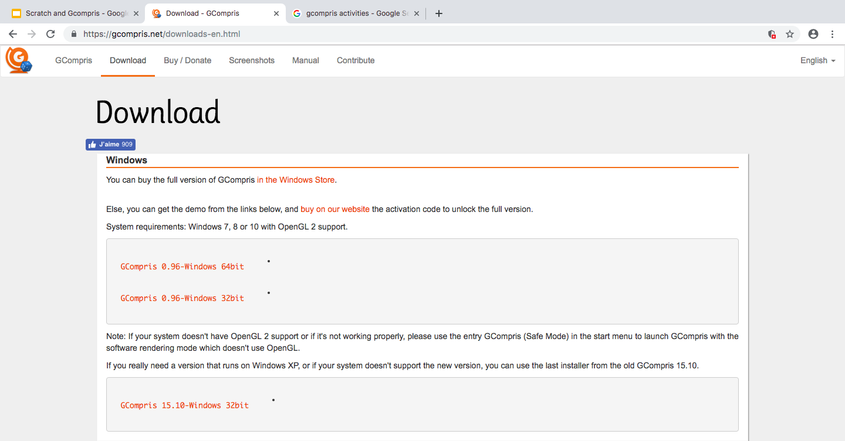
How to install GCompris in windows

Slide 19
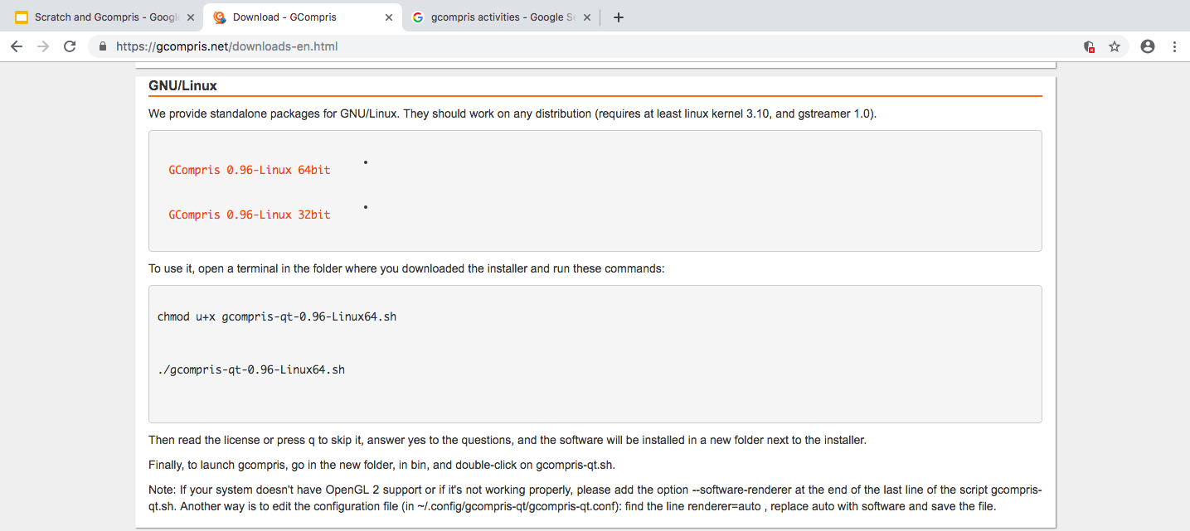
How to download GCompris in linux

Slide 20
Scratch and GCompris - A Quick Glance
Scratch is an application cum programming language that will be useful for children to create their own interactive stories and animations. Scratch can be used in both online and offline modes
GCompris is a high quality educational software suite, including a large number of activities for children aged 2 to 10.Some of the activities are game orientated, but nonetheless still educational.

Slide 21
THANK YOU

